Slide 1





Slide 2







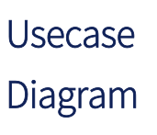


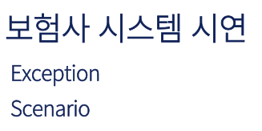

Slide 3










Slide 4

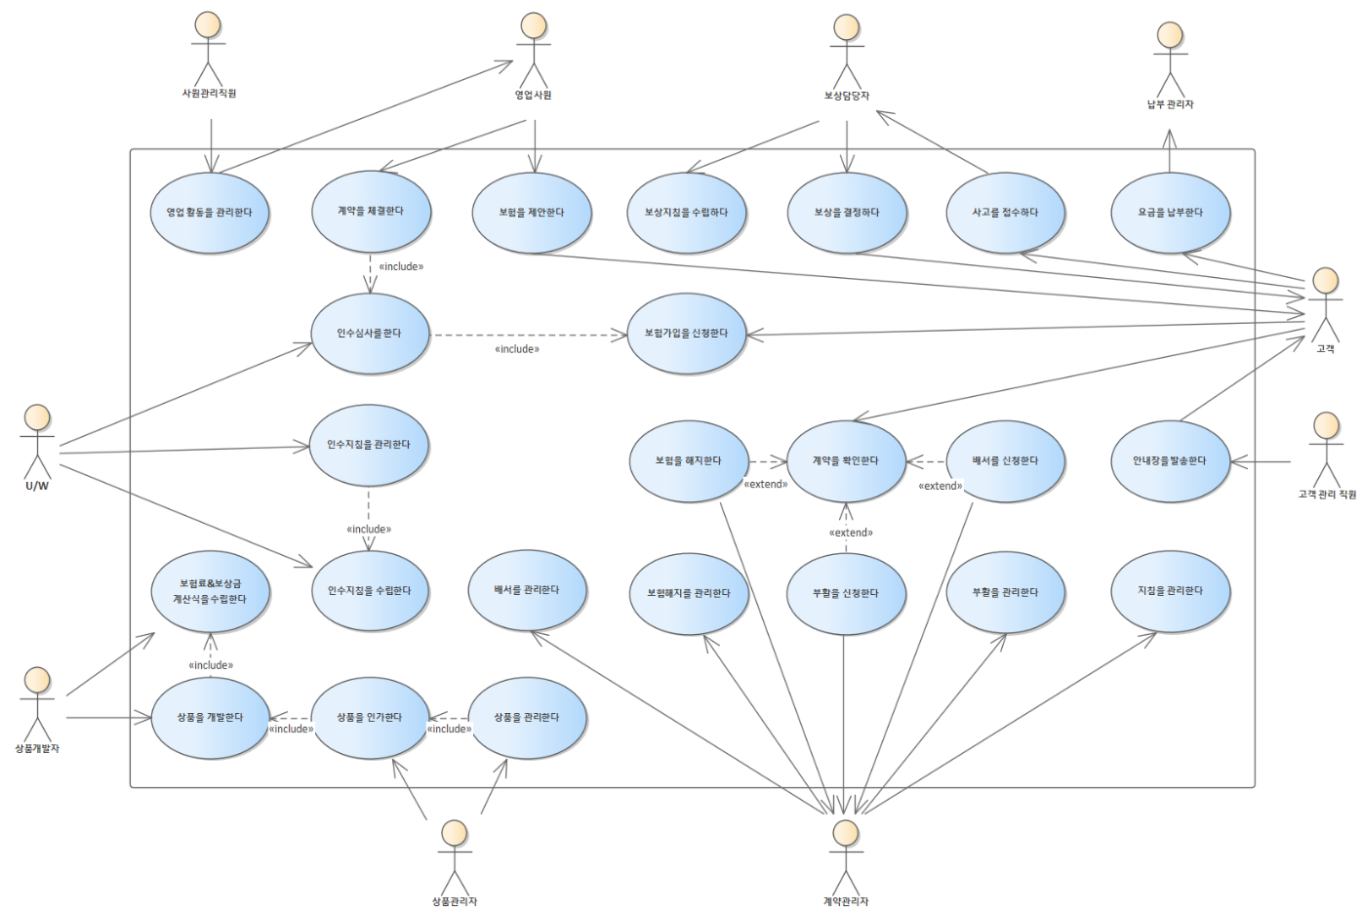

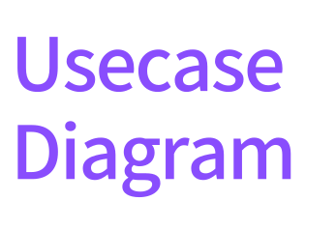


Slide 5






Slide 6





























Slide 7





































Pay
ServiceIF
Contract
ServiceIF
Customer
ServiceIF

Slide 8





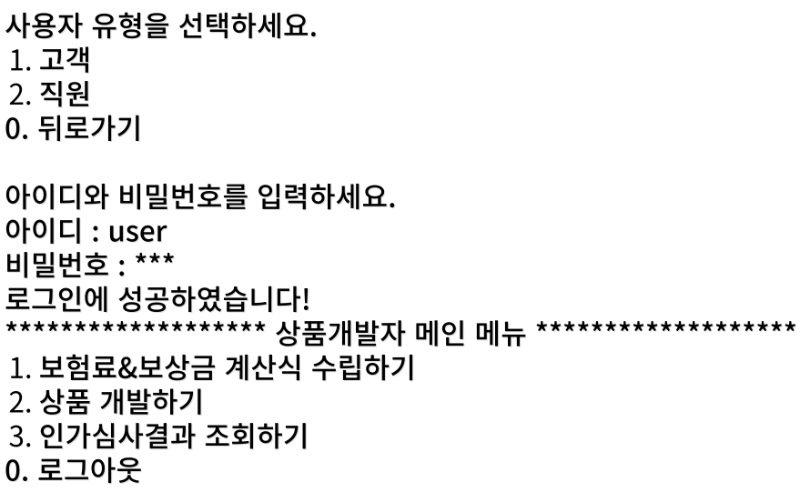

Slide 9



